Slide 1

Fixed Income Fund
Case Study

Slide 2

Agenda
Macroeconomics Overview
Fixed Income Fund Anaysis
Questions

Slide 3

Macro Overview

Slide 4
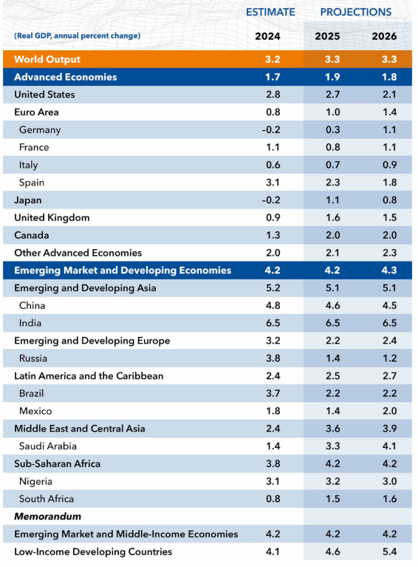
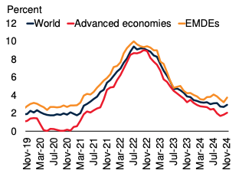
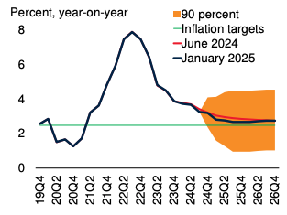
Global
GDP Growth Forecast
Headline CPI Forecast
Source: IMF
Source: World Bank

Slide 5
Global
Global growth projected at 3.3% in both 2025 and 2026, up from 2024's average of 3.2% (IMF)
Global headline inflation is slowing and is expected to reach 2.7% in 2025 and 2.5% in 2026, down from 2024's average of 3% (World Bank)
Economic policy uncertainty has increased sharply in recent months, mostly with the imposition of trade tarrifs by the U.S. Geopolitical tensions in the Middle East and around the Russia/Ukraine conflict which has caused Central Banks to adopt a more cautious approach to easing monetary policy

Slide 6
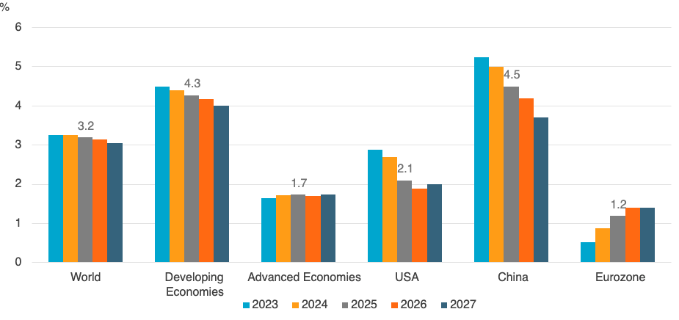
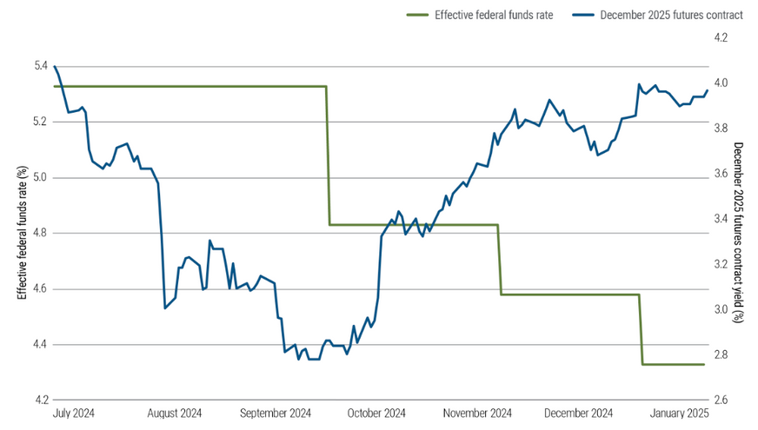
United States
GDP Growth Forecast
FED Funds Rate vs. DEC Futures
Source: Euromonitor International
Source: PIMCO

Slide 7
United States
U.S. GDP growth for 2025 revised up from 2.1% to 2.7%
Economy remains robust with inflation struggling to move below 2.5%
Supported by a mix of strong wealth effects, less restrictive monetary policy, supportive financial conditions and an ongoing increase in employment
Risks include a global trade war due to tarrif impositions and excessive tax cuts that could cause a surge in gvt debt weakening their fiscal position
FOMC have highlighted upside risks and have commented that inflation “remains somewhat elevated” which may prompt the FED to PAUSE on further rate cuts

Slide 8
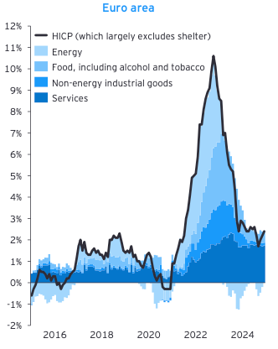
Eurozone
Headline CPI
EU GDP growth forecast to be to 1.2% for 2025 representing a mild recovery from 2024's 0.8%
Inflation briefly fell below ECB’s 2% target in Sep-24 but has since accelerated in each of the last 3 months due to higher energy prices
Sticky inflation along with recent deveopments in the Russia/Ukraine conflict may cause the ECB to take more careful approach to further rate cuts in the short to medium term
Source: EY

Slide 9
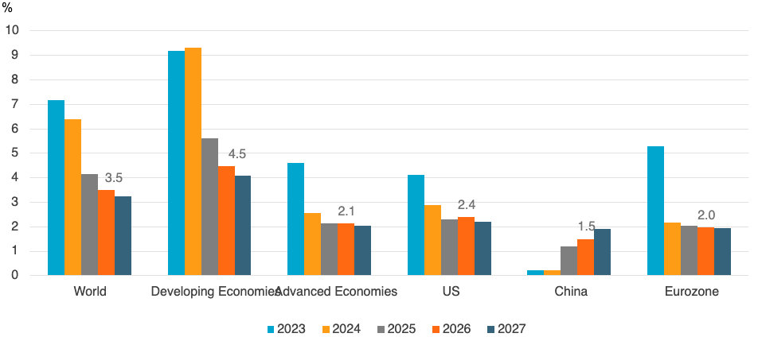
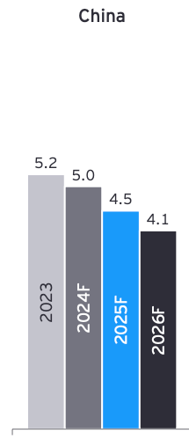
China
CPI Growth Forecast
GDP Growth
Source: Euromonitor International
Source: EY

Slide 10
China
China achieved its GDP growth target of 5% mainly due to the production side of the economy. This despite ongoing challenges, including a property market slump and weak domestic consumer demand
This is reflected in the subdued inflation numbers which averaged 0.2% in 2024, unchanged from 2023 and well below PBoC’s target of 3%
Heavy reliance on government to stimulate consumption in the economy
Escalating trade tensions with the U.S. as well as currency concerns pose a major threat to the growth prospects
Given these risks, GDP is expected to slow to 4.5% in 2025 and 4.1% in 2026

Slide 11
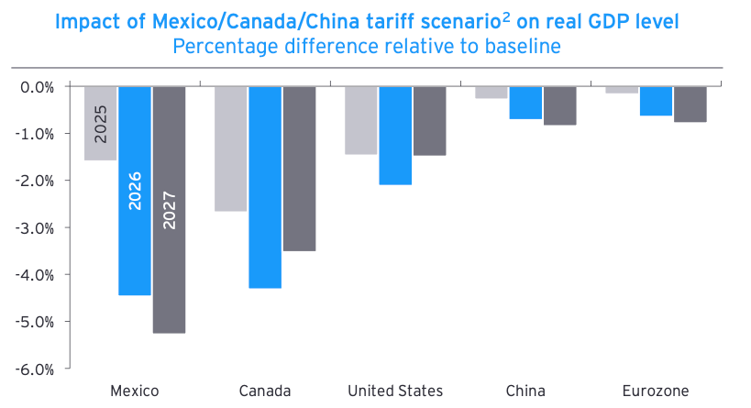
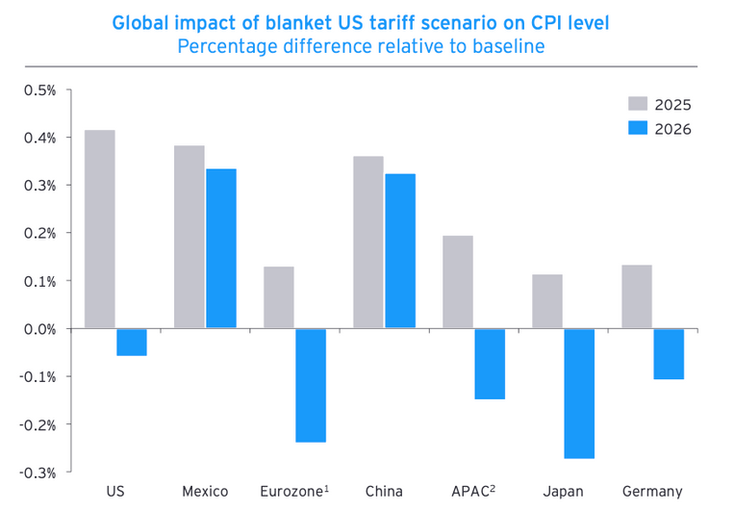
Tariff Impact
GDP Relative to Base
CPI Relative to Base
Source: EY
Source: EY
Scenario assumes 10% tariffs on imports from China and 25% from Mexico and Canada starting in Q1 2025
Significant impact with U.S. real GDP reduced by 1.5% in 2025 and 2.1% in 2026. Increased import costs would lift CPI by 0.4% in 2025 and with the upward pressure to inflation, a more hawkish FED would be disinflationary

Slide 12
Key Takeaways
Global Trade War: The biggest threat is a potential global trade war, primarily initiated by US policies, which could significantly undermine economic fundamentals worldwide
US Policy: The uncertainty surrounding President Trump's economic policies, particularly trade protectionism and fiscal policy, is a major source of risk
Geopolitical Tensions: Ongoing geopolitical tensions, including those in the Middle East and the Russia/Ukraine conflict, continue to pose a threat to economic stability
China's Deflation: China's potential deflationary pressures and uneven growth remain a concern

Slide 13
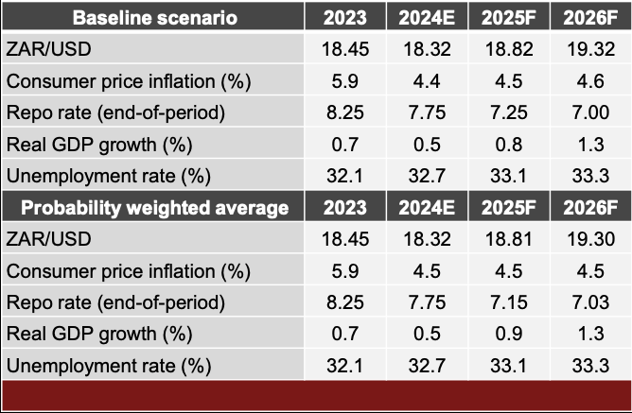
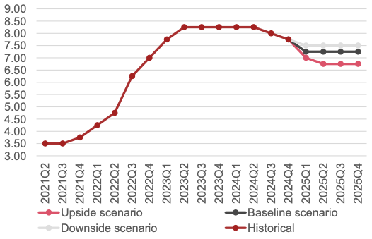
South Africa
Macroeconomic Forecasts
SARB Repo Rate Scenario’s
Source: PwC
Source: PwC

Slide 14
South Africa
GDP Growth expected to average 0.5% for 2024 (Actual 0.6%) with a moderate improvement to 0.8% forecast for 2025 (1.5% IMF) and 1.3% for 2026 (1.6% IMF)
Inflation is expected average 4.4% in 2024. Initial forecasts were for CPI to slow below 4% in 2025, however with increased upside risks to the cost of food, electricity, water, insurance and wages forecasts have been revised upwards
Unemployment remains a challenge due to slow economic growth
Increased unpredictability of the rand due to economic and global risks
Given these risks, inflation is expected to be 4.5% in 2025 and 4.6% in 2026

Slide 15
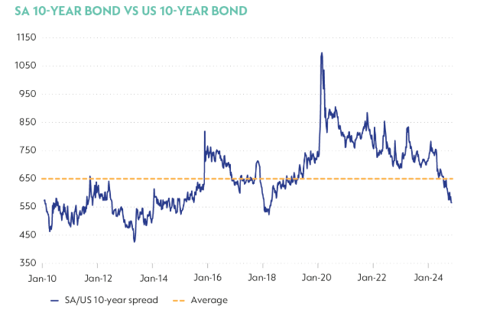
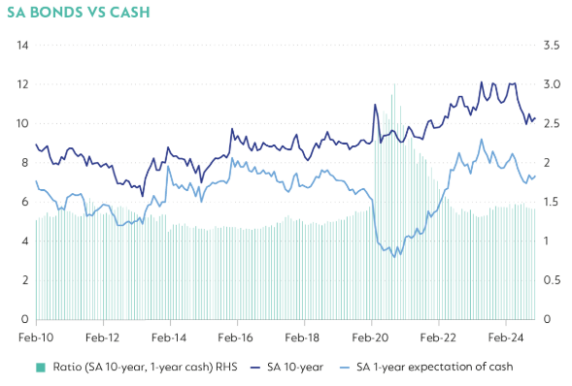
South Africa
SA 10Yr vs. US 10Yr
Bonds vs. Cash
Source: Bloomberg
Source: Bloomberg

Slide 16
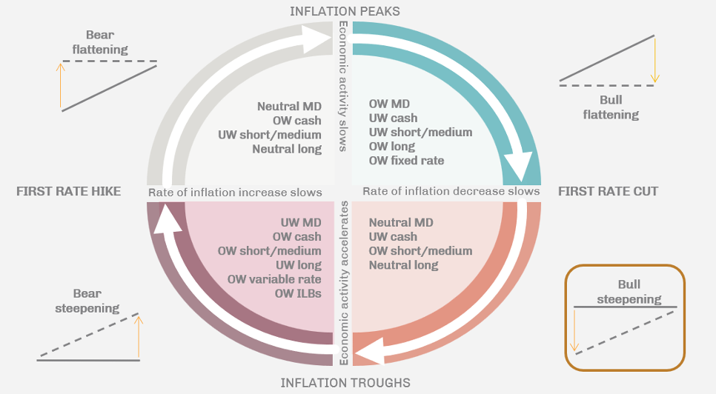
South Africa
Inflation Cycle
Due to the notable upside risks to inflation as well geopolitical and economic uncertainties, it is likely that the SARB will adopt a more cautious approach to interest rate decisions
My view is that they puase for the next few meetings before deciding on the next move
Even though yields are high and offer value, the risk premium (bonds vs. cash and SA 10yr vs. US 10Yr) has come off a bit and I think it would be prudent to have a more defensively positioned portfolio with neutral duration and assets focused in the short-medium end of the curve
Source: CFA Notes

Slide 17
FI Fund Analysis

Slide 18
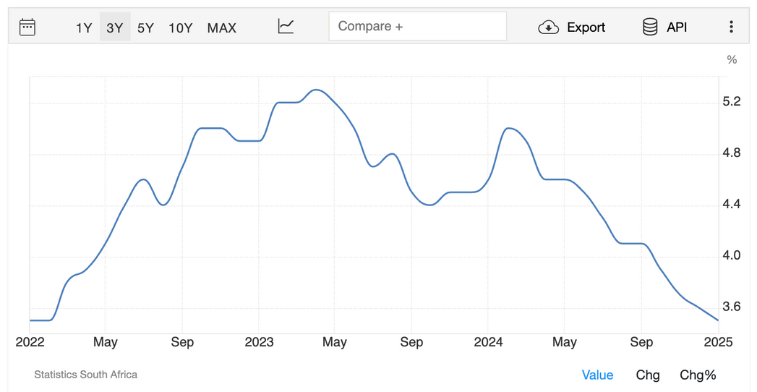
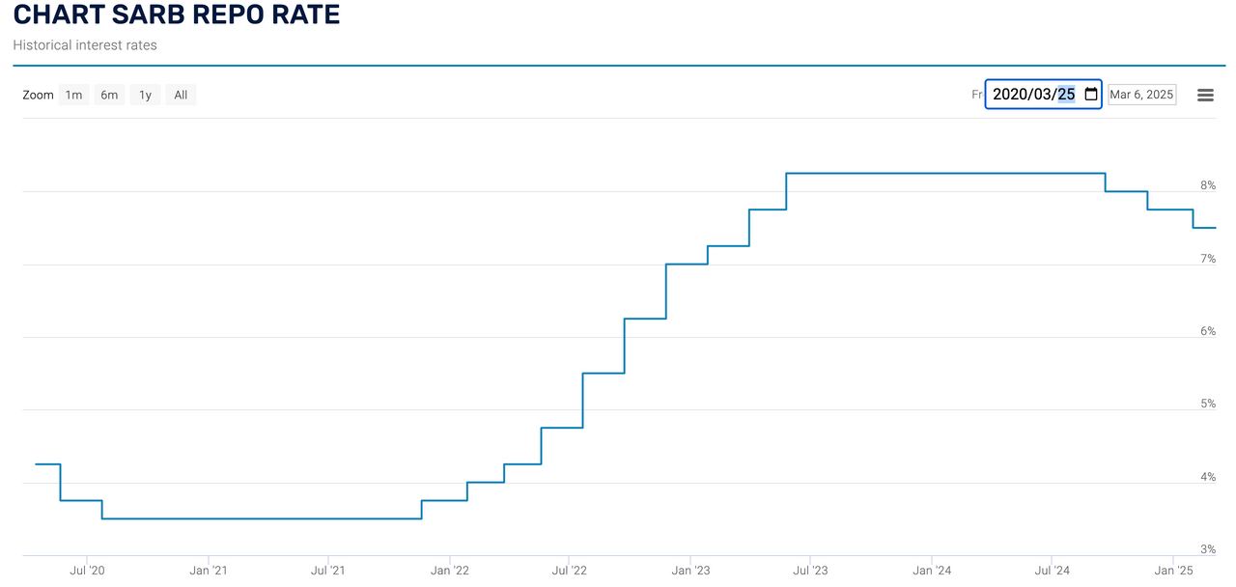
Time Series Analysis
SA CPI
Repo Rate
Source: Stats SA
Source: SARB

Slide 19
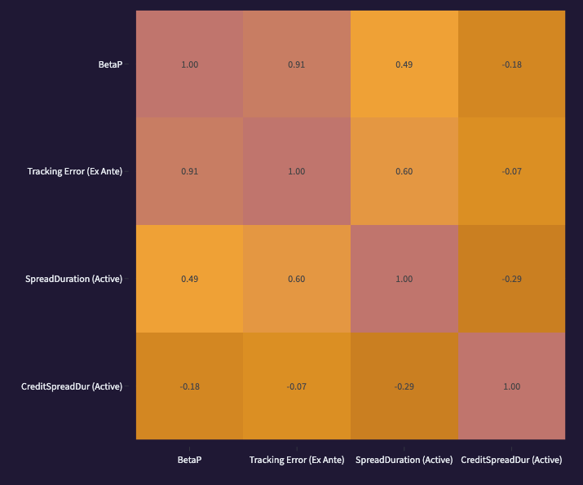
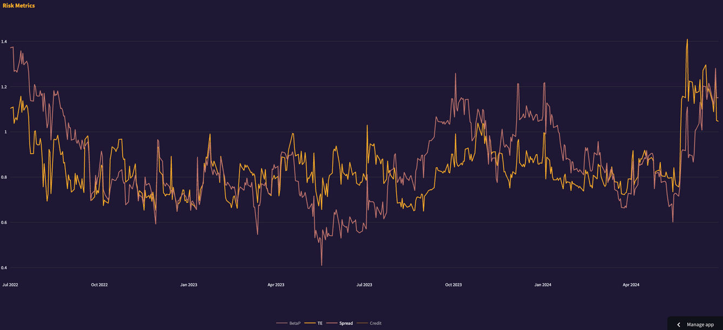


Time Series Analysis
Tracking Error vs. Spread Duration
Correlation Matrix
Portfolio looks to have increased duration around May-2024

Slide 20
Time Series Analysis
Looking at the historical CPI and Repo rates graphs above, we note that in an effort to combat high inflation, the SARB began hiking rates in Oct-21. The cycle continued through 2022 and was paused in July-2023
The aggressive hiking policy taken by the SARB over this period saw the repo rate increase by a cumulative 475bps from 3.5% to 8.25%
Afterwards inflation began to decline but picked up again somewhat leading up to the May-24 elections
Following the relatively smooth elections and a further falling inflation rate which saw the rate print below 3% in Jul-24, the SARB began it’s rate cutting cycle in September of last year

Slide 21
Time Series Analysis
Looking at the numbers for the Tracking Error (T/E) vs. Spread Duration (Interest Rate sensitivity), we note that the fund was relatively defensively positioned during the hiking period
T/E and Spread Duration appeared fairly correlated with each other and given the lower duration figures (< 1), suggests that the fund was below the benchmark duration
Following the successful elections last year and again with the falling inflation, the portfolio Spread Duration was increased in May-24. This mostly likely in anticipation of impending rate cuts that would come through from the SARB
The timing of this was nearly perfect as the SARB began cutting rates in Sep-24

Slide 22
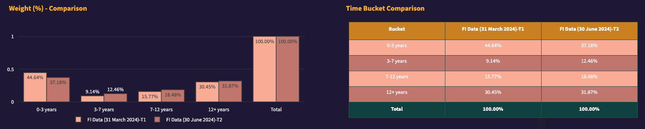
Time Period Comparison
Portfolio Change - Weight (%)
The insights drawn from the time series analysis above is further supported when comparing the portfolio between March-24 and June-24. Considering the time bucket exposure, we note that portfolio weights were increased by around 3% in each of the 3-7 years and 7-12 years buckets with a marginal increase of just over 1% in 12+ years
The decrease in the 0-3 years was mainly drawn from cash

Slide 23
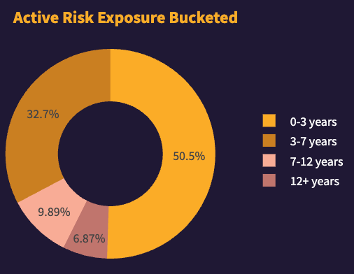
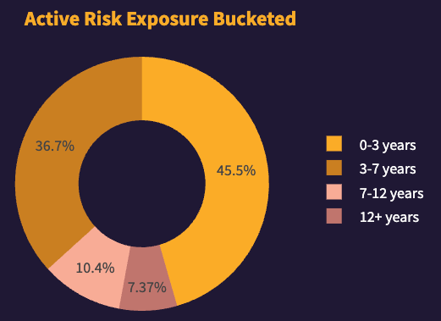
Time Period Comparison
FI Data (31 March 2024)
FI Data (30 June 2024)
The same conclusion can be drawn when looking at the ative risk between the time periods. The fund most likely added to duartion by reallocating funds towards the belly (middle) of the curve

Slide 24
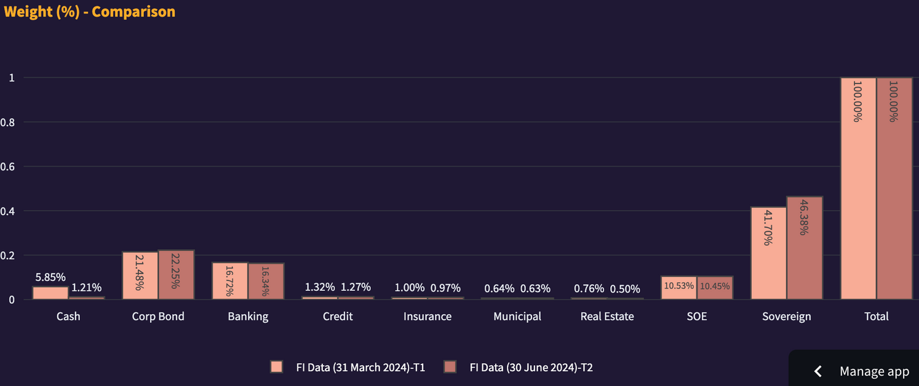
Time Period Comparison
Portfolio Change - Weight (%)
The Sector breakdown reveals that 4.6% of cash was moved into government bonds
Other noteworthy insights were the Asset Swap holdings in the fund which seemed to increase over the two periods

Slide 25
THANK YOU
Questions?

